Slide 1
Relativistic Velocity

Slide 2
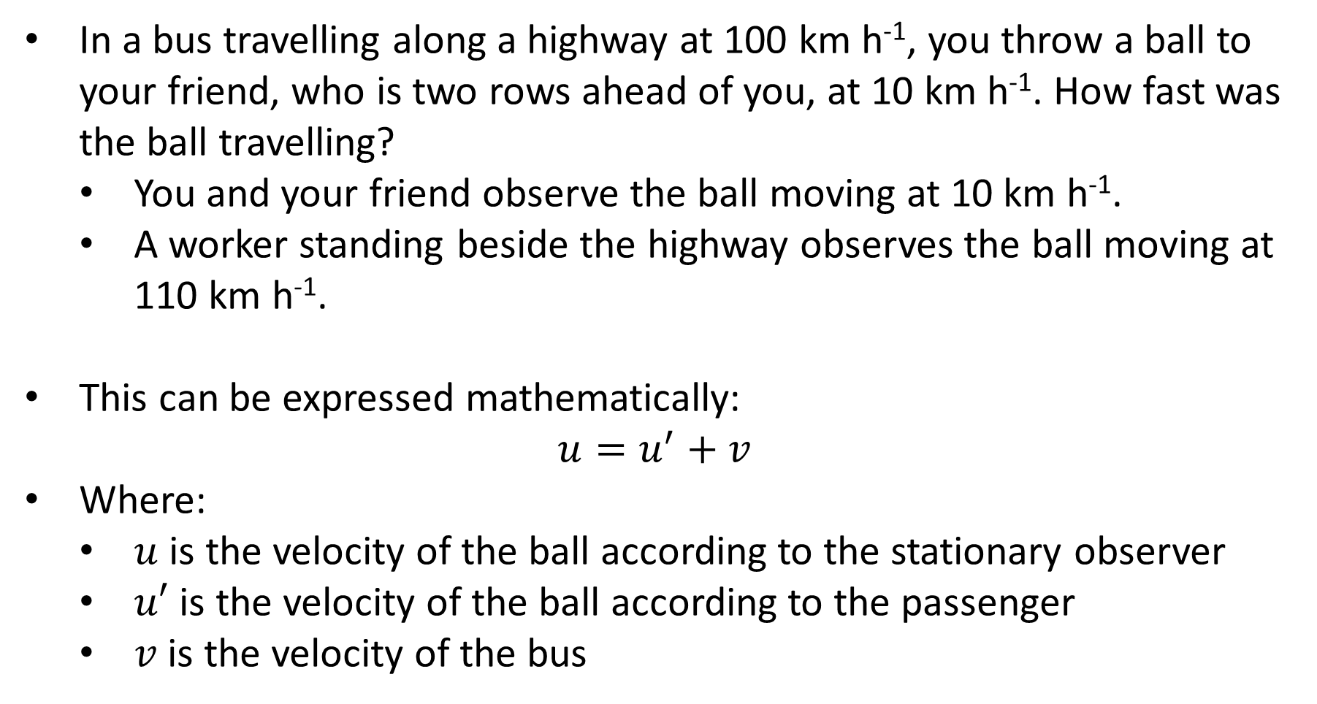
Galilean Relativity Review
In a bus travelling along a highway at 100 km h⁻¹, you throw a ball to your friend, who is two rows ahead of you, at 10 km h⁻¹. How fast was the ball travelling?
You and your friend observe the ball moving at 10 km h⁻¹.
A worker standing beside the highway observes the ball moving at 110 km h⁻¹.
This can be expressed mathematically:
$$u=u^{′}+v$$
Where:
$u$ is the velocity of the ball according to the stationary observer
$u′$ is the velocity of the ball according to the passenger
$v$ is the velocity of the bus

Slide 3
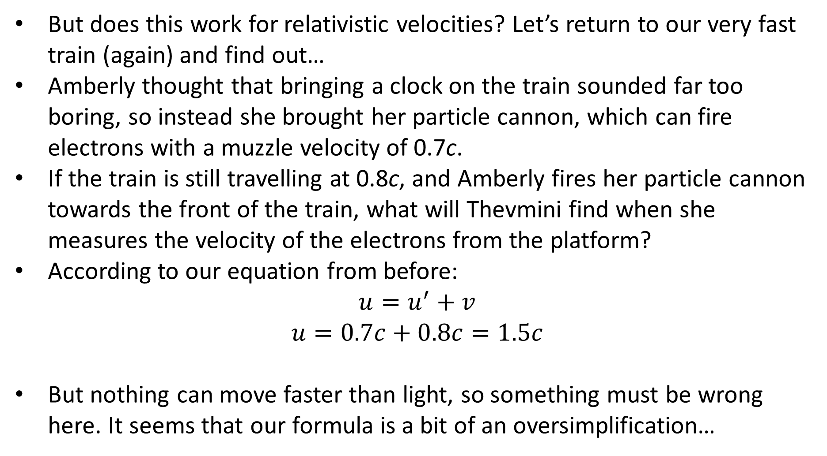
Relativistic Velocity
But does this work for relativistic velocities? Let’s return to our very fast train (again) and find out…
Amberly thought that bringing a clock on the train sounded far too boring, so instead she brought her particle cannon, which can fire electrons with a muzzle velocity of 0.7c.
If the train is still travelling at 0.8c, and Amberly fires her particle cannon towards the front of the train, what will Thevmini find when she measures the velocity of the electrons from the platform?
According to our equation from before:
$$u=u^{′}+v$$
$$u=0.7c+0.8c=1.5c$$
But nothing can move faster than light, so something must be wrong here. It seems that our formula is a bit of an oversimplification…

Slide 4
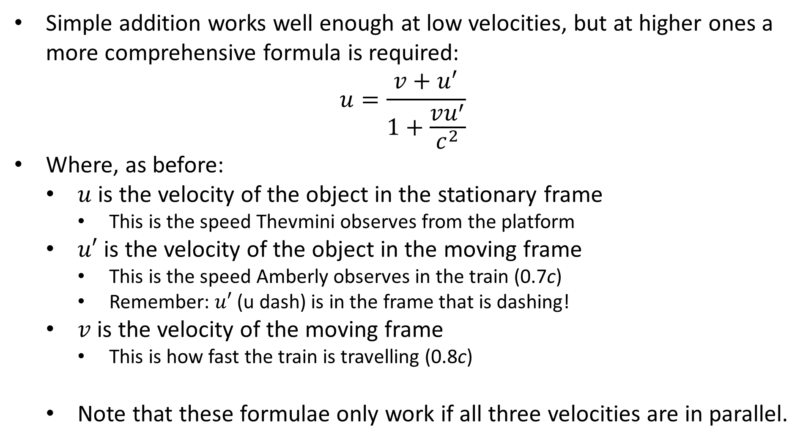
Relativistic Velocity
Simple addition works well enough at low velocities, but at higher ones a more comprehensive formula is required:
$$u=\frac{v+u^{′}}{1+\frac{vu^{′}}{c^{2}}}$$
Where, as before:
$u$ is the velocity of the object in the stationary frame
This is the speed Thevmini observes from the platform
$u′$ is the velocity of the object in the moving frame
This is the speed Amberly observes in the train (0.7c)
Remember: $u′$ (u dash) is in the frame that is dashing!
$v$ is the velocity of the moving frame
This is how fast the train is travelling (0.8c)
Note that these formulae only work if all three velocities are in parallel.

Slide 5
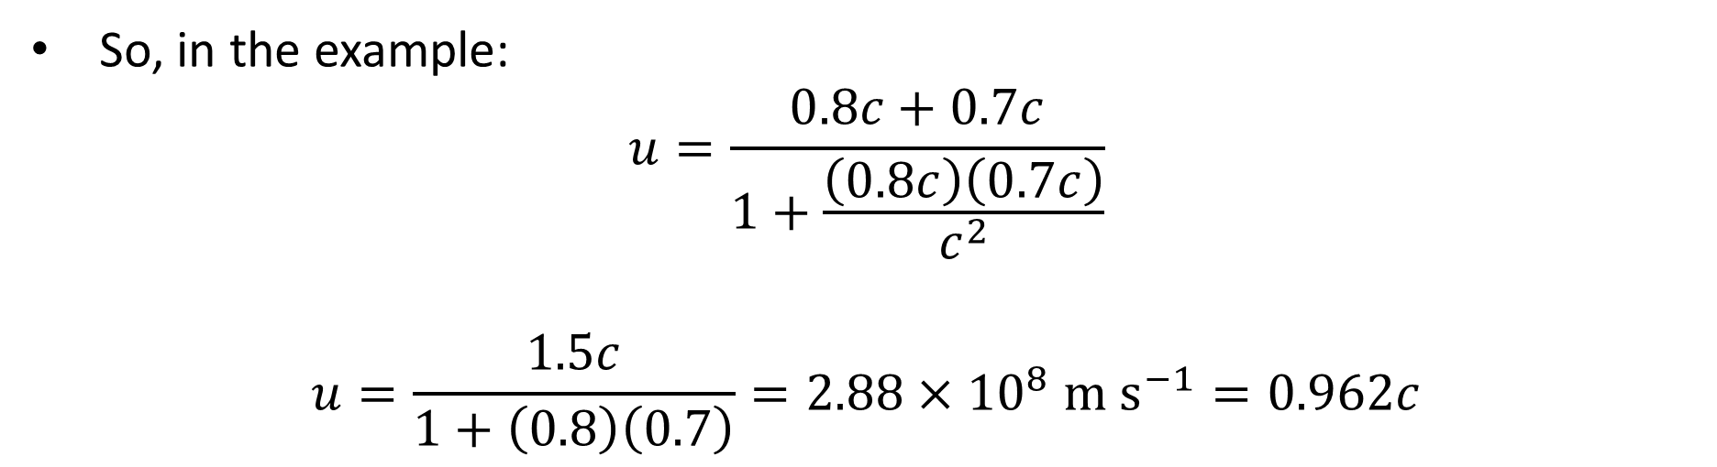
Relativistic Velocity
So, in the example:
$$u=\frac{0.8c+0.7c}{1+\frac{\left(0.8c\right)\left(0.7c\right)}{c^{2}}}$$
$$u=\frac{1.5c}{1+\left(0.8\right)\left(0.7\right)}=2.88×{10}^{8} \text{m} {\text{s}}^{−1}=0.962c$$

Slide 6
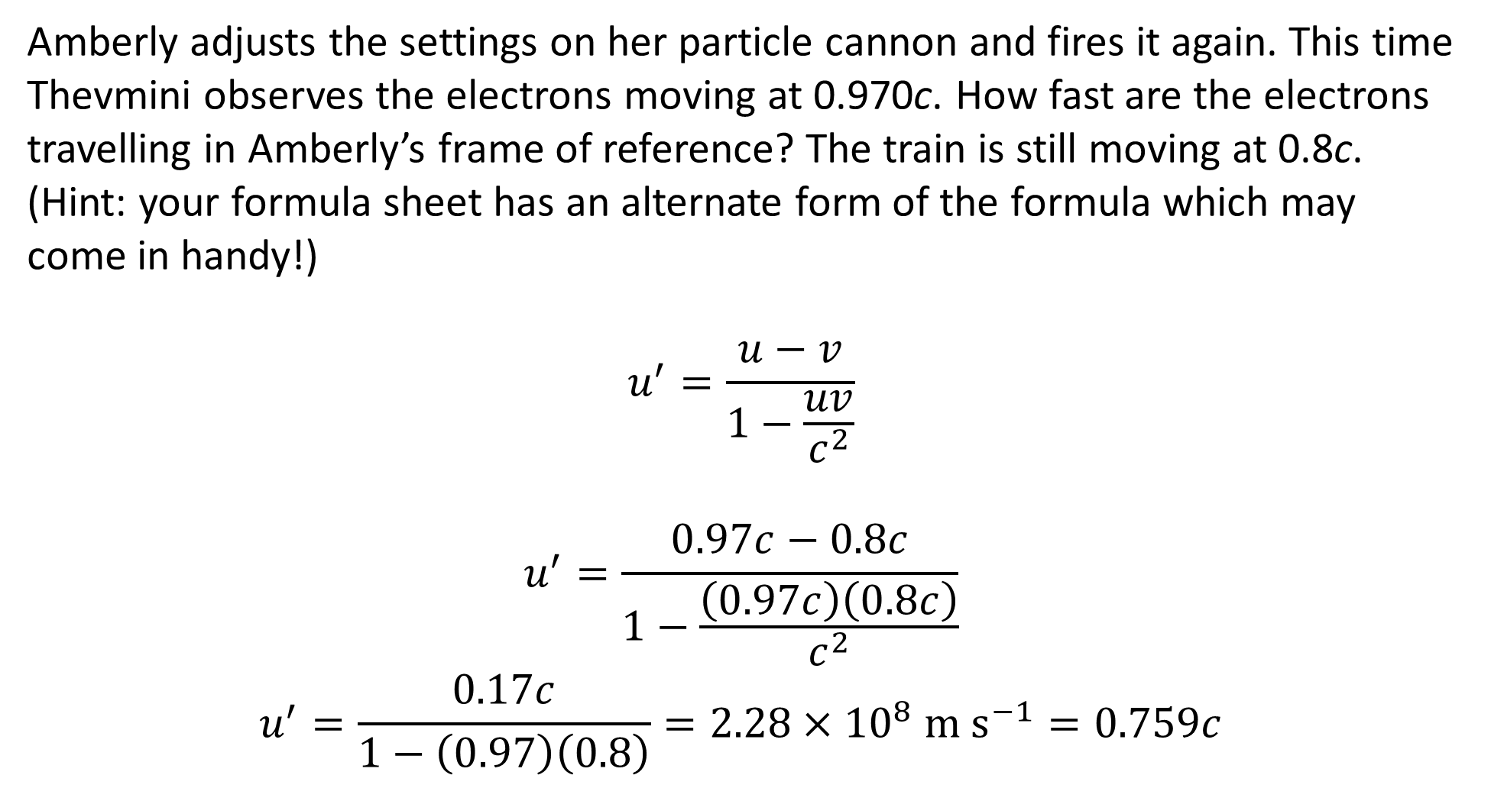
Example #1
Amberly adjusts the settings on her particle cannon and fires it again. This time Thevmini observes the electrons moving at 0.970c. How fast are the electrons travelling in Amberly’s frame of reference? The train is still moving at 0.8c. (Hint: your formula sheet has an alternate form of the formula which may come in handy!)
$$u^{′}=\frac{u−v}{1−\frac{uv}{c^{2}}}$$
$$u^{′}=\frac{0.97c−0.8c}{1−\frac{\left(0.97c\right)\left(0.8c\right)}{c^{2}}}$$
$$u^{′}=\frac{0.17c}{1−\left(0.97\right)\left(0.8\right)}=2.28×{10}^{8} \text{m} {\text{s}}^{−1}=0.759c$$

Slide 7
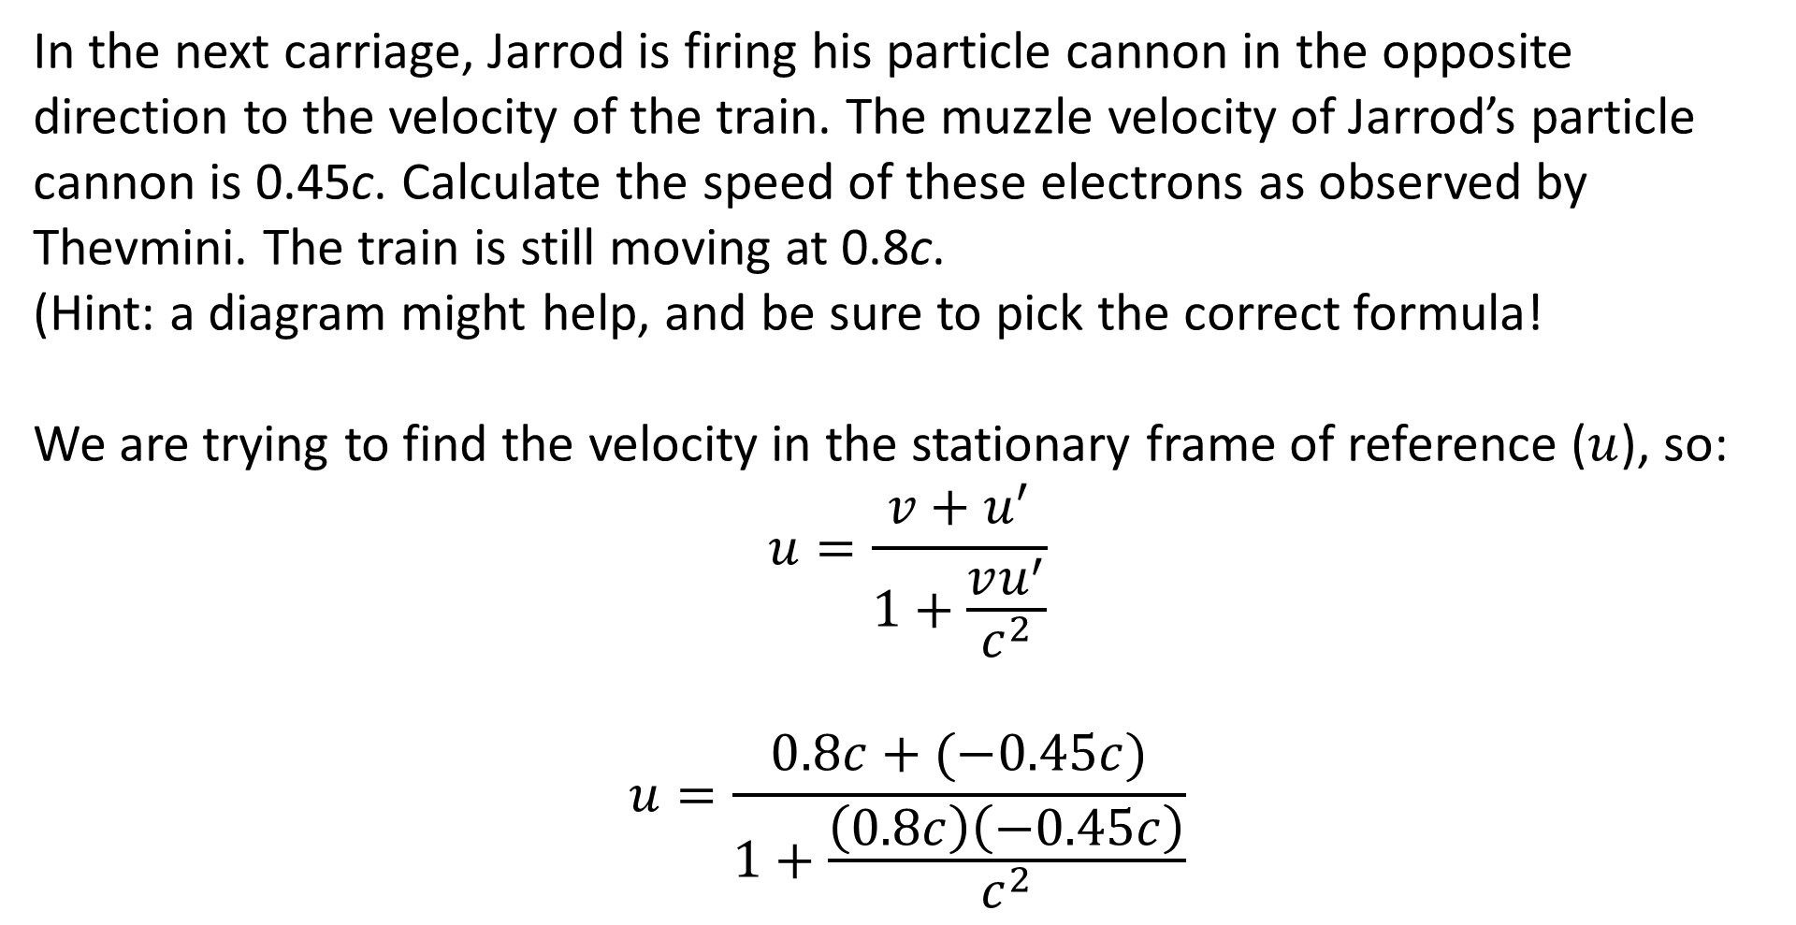
Example #2
In the next carriage, Jarrod is firing his particle cannon in the opposite direction to the velocity of the train. The muzzle velocity of Jarrod’s particle cannon is 0.45c. Calculate the speed of these electrons as observed by Thevmini. The train is still moving at 0.8c. (Hint: a diagram might help, and be sure to pick the correct formula!
We are trying to find the velocity in the stationary frame of reference ($u$), so:
$$u=\frac{v+u^{′}}{1+\frac{vu^{′}}{c^{2}}}$$
$$u=\frac{0.8c+(−0.45c)}{1+\frac{\left(0.8c\right)\left(−0.45c\right)}{c^{2}}}$$

Slide 8
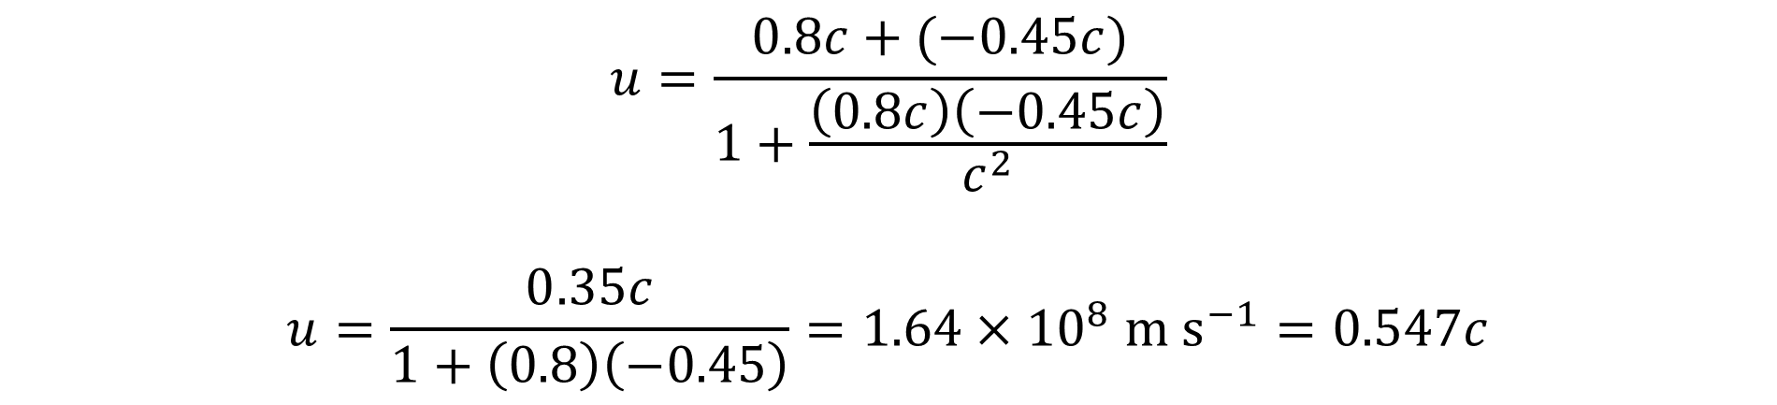
Example #2
$$u=\frac{0.8c+(−0.45c)}{1+\frac{\left(0.8c\right)\left(−0.45c\right)}{c^{2}}}$$
$$u=\frac{0.35c}{1+\left(0.8\right)\left(−0.45\right)}=1.64×{10}^{8} \text{m} {\text{s}}^{−1}=0.547c$$

Slide 9
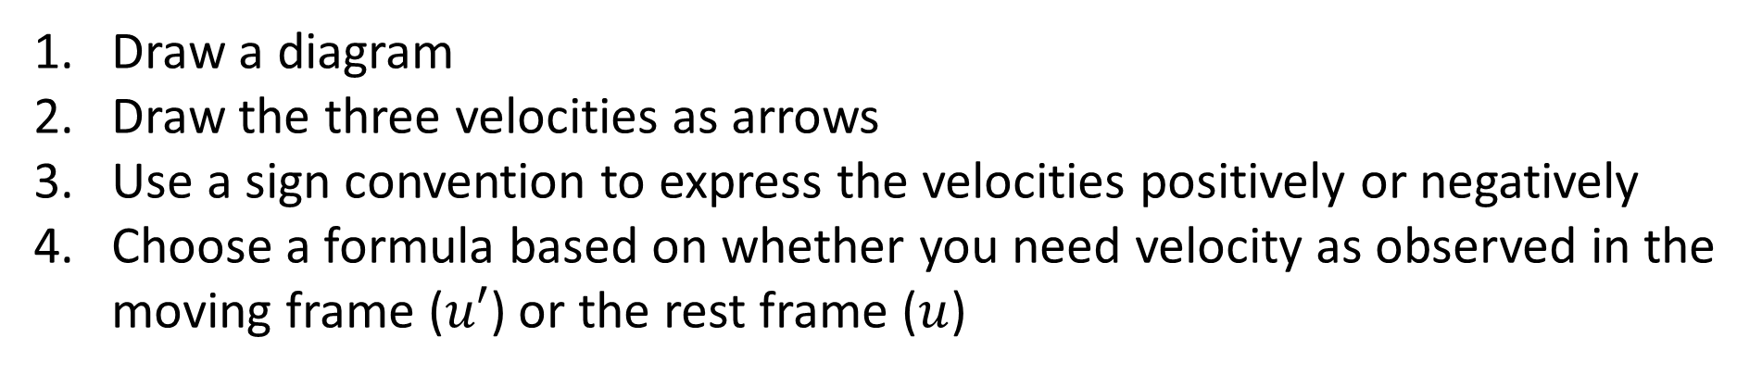
Solving Relativistic Velocity Problems
Draw a diagram
Draw the three velocities as arrows
Use a sign convention to express the velocities positively or negatively
Choose a formula based on whether you need velocity as observed in the moving frame ($u′$) or the rest frame ($u$)

Slide 10
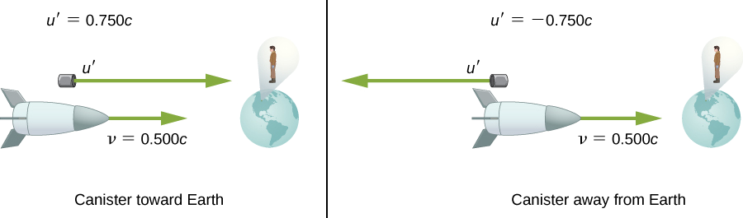
Example #3
Suppose a spaceship approaches Earth at half the speed of light and shoots a canister at a speed of 0.750c.
In terms of c, at what velocity does an earthbound observer see the canister if:
it is shot directly toward Earth?
it is shot directly away from Earth?
At what speed does the earthbound observer see the ship and the canister move apart in each of the above examples? How does this compare to classical expectations?
Notes:
0.909c
-0.400c
0.409c for part a), which is less than the classically expected 0.750c; 0.900c for part b), which is greater than the classically expected 0.750c. The differences aren’t even symmetric!
Source: https://phys.libretexts.org/Bookshelves/University_Physics/Book%3A_University_Physics_(OpenStax)/University_Physics_III_-_Optics_and_Modern_Physics_(OpenStax)/05%3A__Relativity/5.07%3A_Relativistic_Velocity_Transformation

